Slide 1

Rockbuster Company Strategy
Tammy Sique
January 2023

Slide 2

Agenda
Purpose of Analysis
Rockbuster Worldwide Customers
Movie Revenue
Rental Duration
Top Customers
Rockbuster Worldwide Sales Figures
Recommendations

Slide 3
Purpose of Analysis
Rockbuster is transitioning from being a physical store to an online rental service in order to compete with other streaming resources.
Key questions and objectives:
Which countries are Rockbuster’s customers based in?
Which movies contributed the most revenue? Least?
What was the average rental duration for all videos?
Where are customers with a high lifetime value based?
Do sales figures vary between geographic regions?

Slide 4
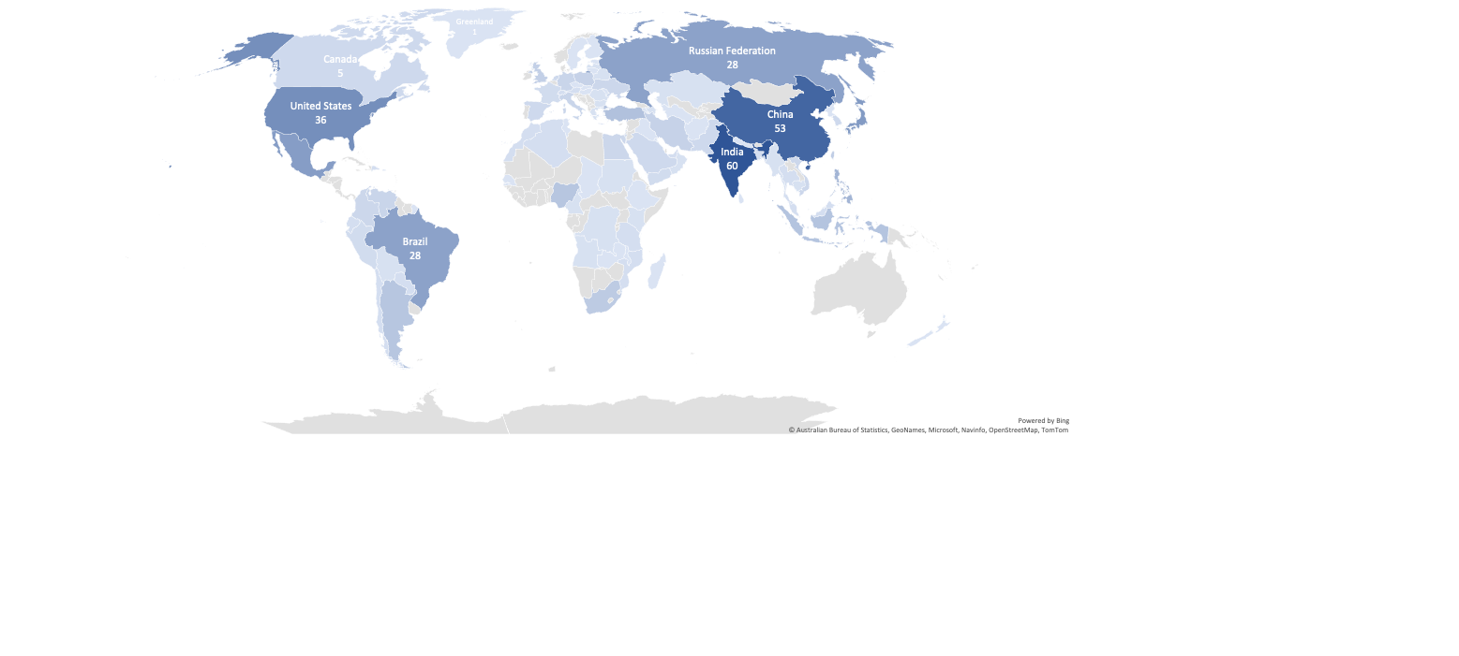
Rockbuster Worldwide Customers
From this world map we can see India, China, the United States, Mexico, and Japan are where most of our customers come from.
Notes:
Hover over countries for country name and customer count.

Slide 5
Movie revenue
Top 10 movies
Title | Rating | Genre | Total Payment
Telegraph Voyage | PG | Music | $216
Zorro Ark | NC-17 | Comedy | $200
Wife Turn | NC-17 | Documentary | $199
Innocent Usual | PG-13 | Foreign | $192
Hustler Party | NC-17 | Comedy | $191
Saturday Lambs | G | Sports | $191
Titans Jerk | PG | Sci-Fi | $187
Harry Idaho | PG-13 | Drama | $178
Torque Bound | G | Drama | $170
Dogma Family | G | Animation | $169
Last 10 movies
Title | Rating | Genre | Total Payment
Texas Watch | NC-17 | Horror | $6
Oklahoma Jumanji | PG | New | $6
Duffel Apocalypse | G | Documentary | $6
Freedom Cleopatra | PG-13 | Comedy | $6
Rebel Airport | G | Music | $7
Young Language | G | Documentary | $7
Treatment Jekyll | PG | Drama | $7
Cruelty Unforgiven | G | Classics | $7
Lights Deer | R | Classics | $8
Stallion Sundance | PG-13 | Sci-Fi | $8
The top and last 10 movies gives us a glance as to which ratings and genres are being viewed.
We will continue to look at genres to know better which are being viewed more frequently.

Slide 6
Movie Revenue Continued
Looking at each genre’s total revenue we can see our top 5 genres are sports, animation, action, family, and sci-fi.
We can also see that thriller movies generated significantly less revenue than the rest of the genres.

Slide 7
Rental Duration
Minimum
Average
Maximum
1
2
3
4
5
6
7
8
9
10
We can see from this number line our rental durations by number of days letting us know how long customers are renting out a movie for.

Slide 8
Sales Figures
Top 10 Countries
Country | Customer Count | Total Payment
India | 60 | $6,035
China | 53 | $5,251
United States | 36 | $3,685
Japan | 31 | $3,123
Mexico | 30 | $2,985
Brazil | 28 | $2,919
Russian Federation | 28 | $2,766
Philippines | 20 | $2,220
Turkey | 15 | $1,498
Indonesia | 14 | $1,353
SUM | 315 | $31,834
Top 5 Customers
Country | City | Total Paid
Mexico | Atlixco | $129
Turkey | Sivas | $109
Mexico | Celaya | $103
United States | Aurora | $99
India | Adoni | $98
The top 10 countries show us where most of the revenue and customers are located.
The top 5 customers come from one of the top 10 countries, which gives us insight not only who, but where we should be focusing on.

Slide 9
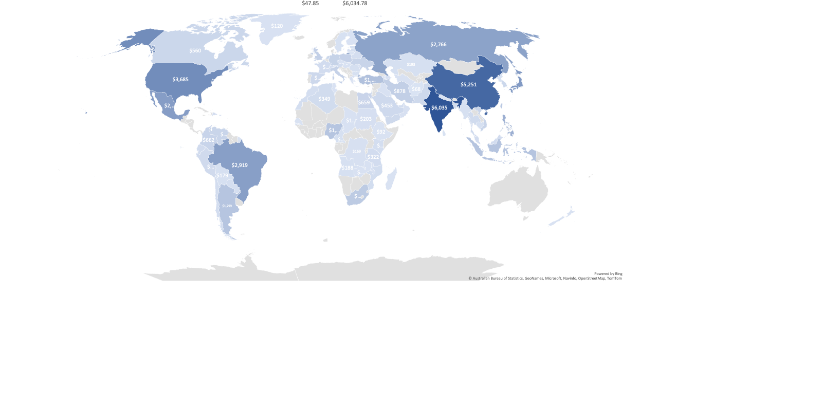
Rockbuster Worldwide Sales Figures

Slide 10
Recommendations
Focus on top 5 countries:
India, China, United States, Japan, and Mexico for streaming service first.
Advertise top genres:
Sports, animation, action, family, and sci-fi
Provide incentives to customers
Discount to top 5 customers
Begin a referral program
One free month for each person who uses the customers referral code
Additional Analysis
Launch a formal customer segmentation based on data we already have then A/B test it
Figure out why thriller has the least sales – least amount of options?
Find out the top genre’s per country to properly advertise.
Base advertisements based upon country’s top genres

Slide 11
Questions
Feel free to contact me with any questions or further insight.
tsique@gmail.com

